Slide 1
CSE 170 Technical Teamwork
W. Clements
Week 03 Day 1

Slide 2
Agenda
Review: Teamwork
Blooket
Introvert vs Extraverts vs Ambiverts
Is all about the shoes
Differences – Good or Bad
Myers Briggs
Weekly Scenarios
Prove Assignment

Slide 3
Agenda
Assignments for the week
Teach One Another 03 - Awareness

Slide 4
Prepare 03 - Awareness
Instructions
Study all of the following materials carefully:
Why Self-Awareness is Essential to Workplace Success
To Improve Your Team First Work on Yourself
An Overview of the Myers-Briggs Type Indicator
Kevin Porter Case Study - Part A
Review the following statements. If you agree with all of them, continue on. If not, continue studying the preparation materials until you can. I know what self-awareness is.
I know how to develop self-awareness.
I know how self-awareness and personal accoutability are related.
I know how self-awareness and teamwork are related.
Explain what you know about self-awareness to someone who is not a current student in the course.

Slide 5
Teach One Another 03 - Awareness
Participate in a case discussion with your team. If you are enrolled in an online section of the course arrange to meet with your team remotely for at least a half-hour. If you are in an on campus section of the course you will be given the opportunity to meet during class. Be sure to thoroughly address each of the following questions during your meeting.
Does anyone have questions about the preparation materials?
What personality type do you think Kevin has?
Would greater self-awareness help Kevin in this situation? Why or why not?
What do you think Kevin should do?
Participate in a case discussion with your class. If you are enrolled in an online section of the course follow the directions given by your instructor to do so. If you are enrolled in an oncampus section of the course you will be given the opportunity during class.

Slide 6
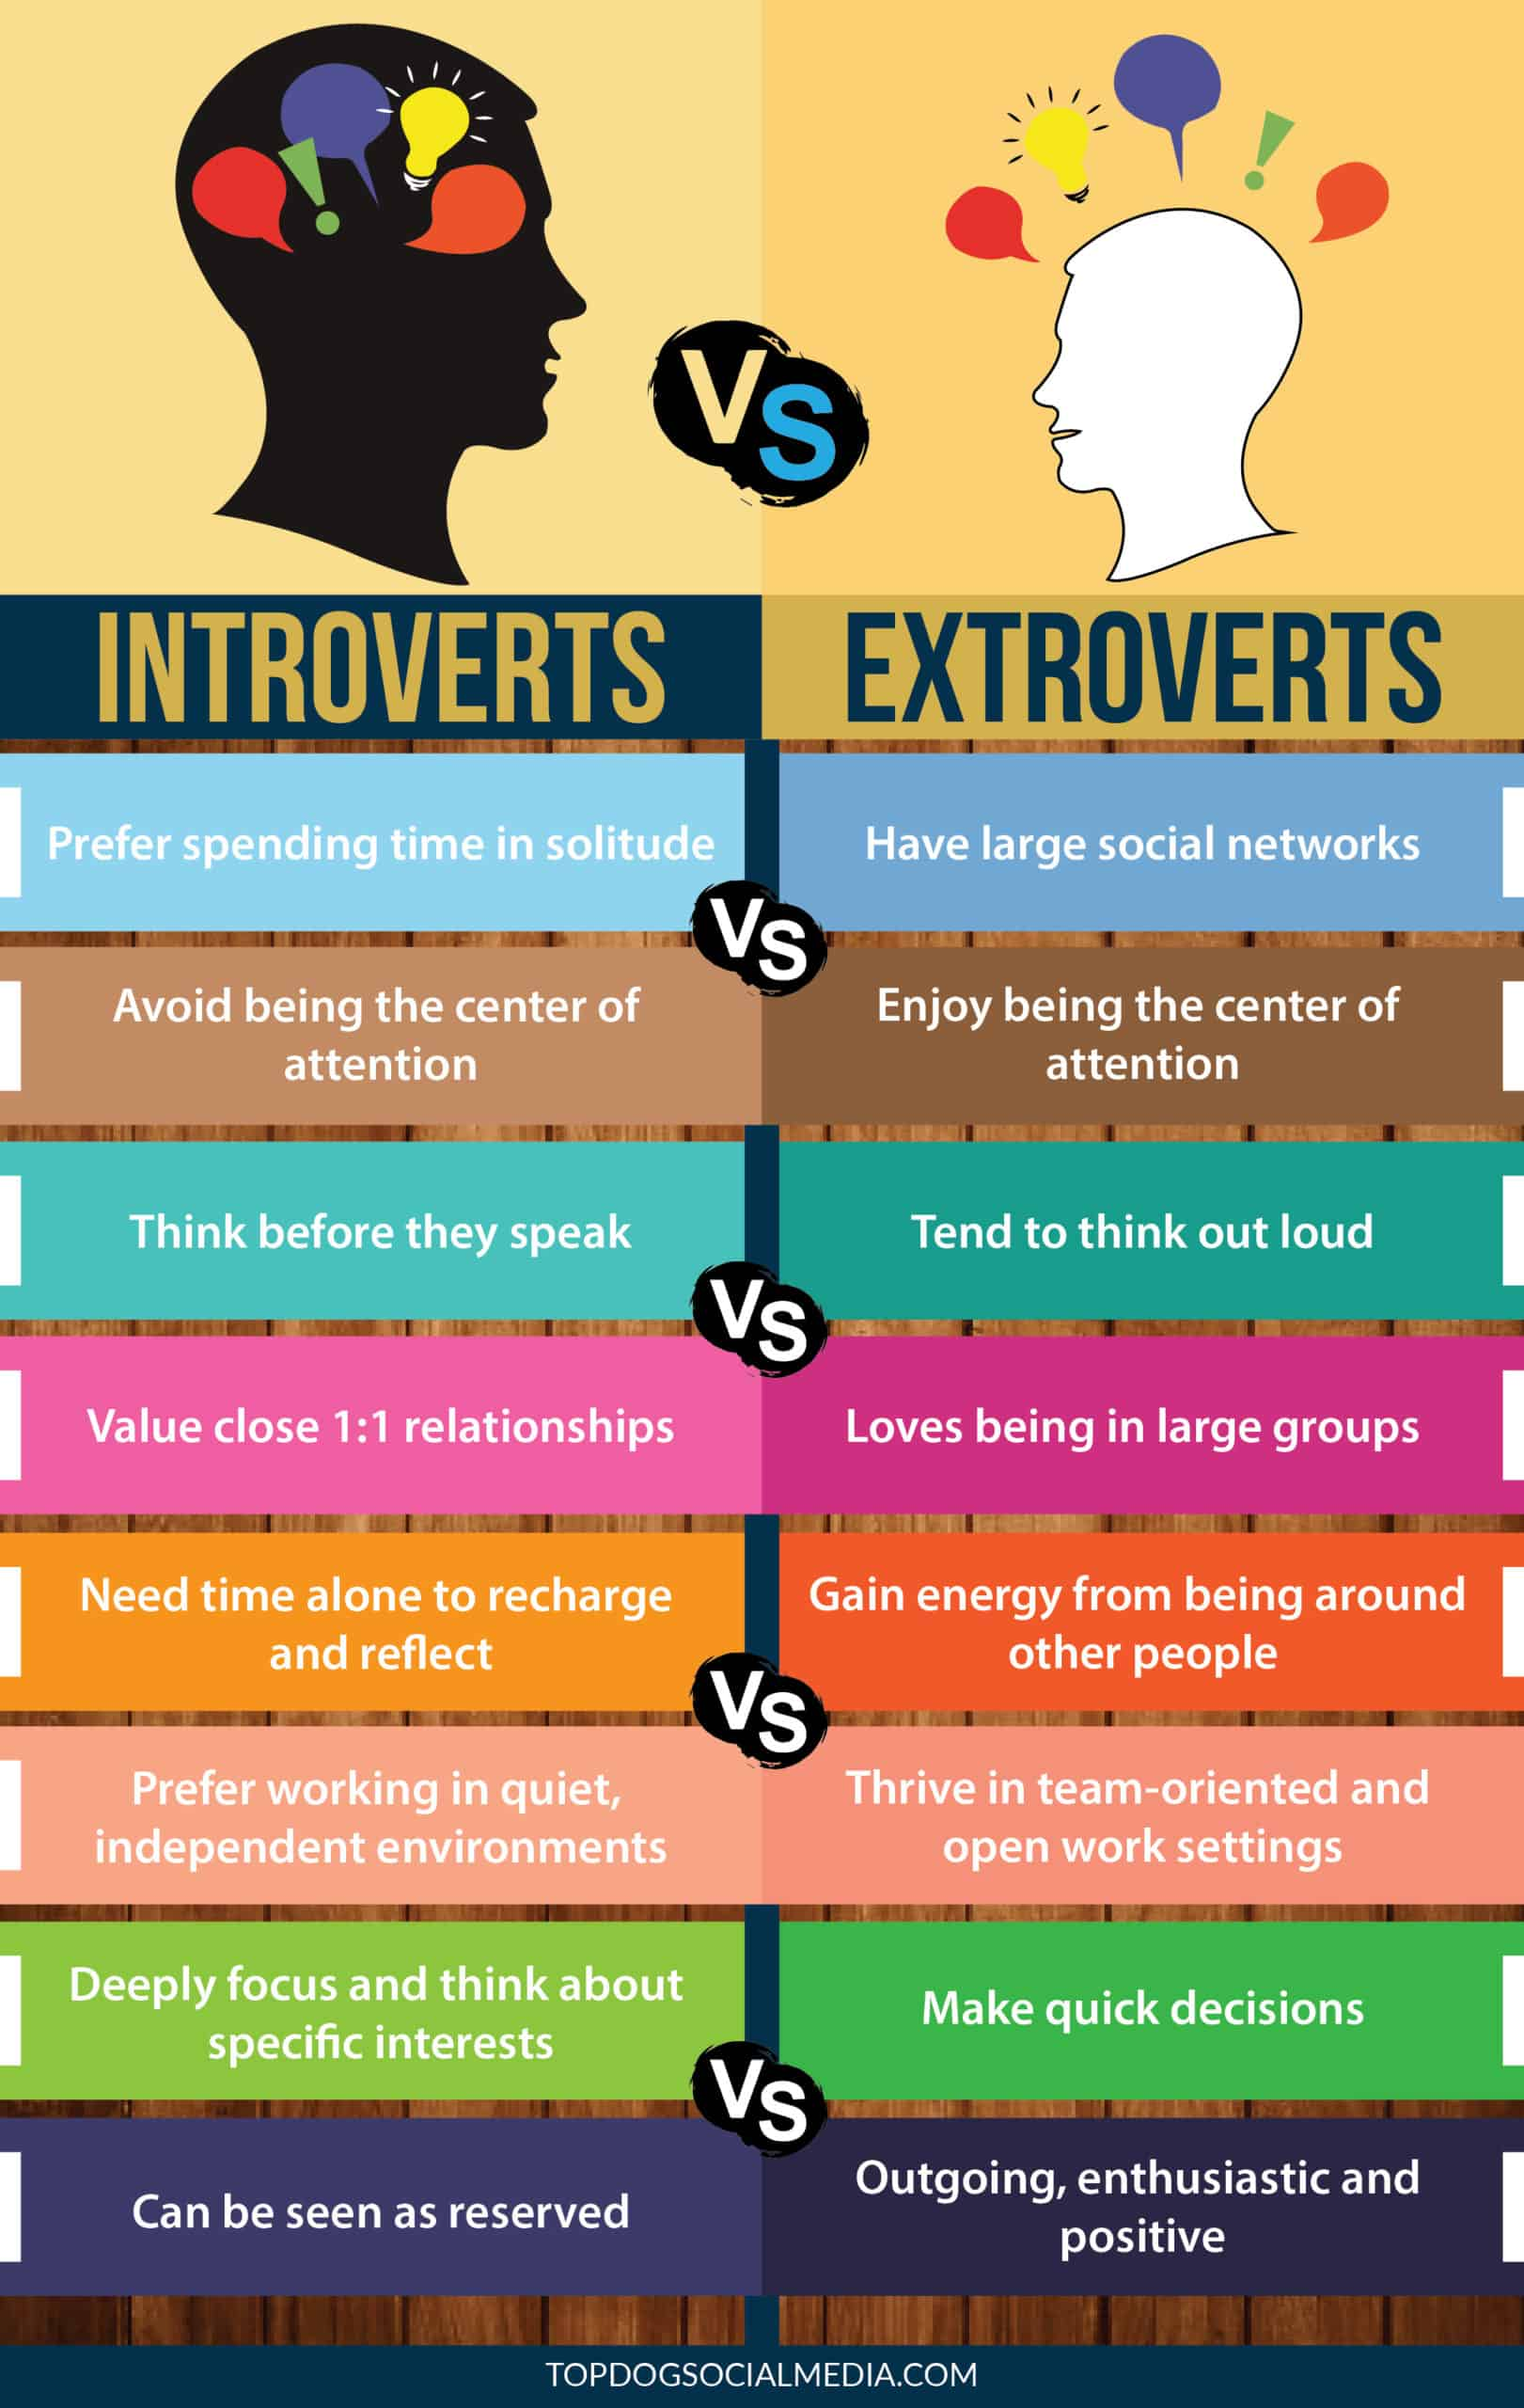
Which are you?

Slide 7
Extroverts, Introverts, and Everything in Between
What it means to be more extroverted
What it means to be an introvert
You enjoy working in a group
You’re always ready to try something new
Talking through a problem often helps you solve it
You find it easy to express yourself
Spending time alone can drain you
You find the good in everything
You make friends easily
You consider things carefully
You prefer to avoid conflict
You’re good at visualizing and creating
You’re a natural listener
You need plenty of time for yourself

Slide 8
Extroverts, Introverts, and Everything in Between
What it means if you fall in between the
two
Can you change where you fall on the
scale?
You do well in social settings and alone
Active listening comes naturally to you
You’re flexible when it comes to problem solving
You’re more decisive than impulsive
Drawing others out is a natural talent
You adapt easily to new situations
Differences:
learning and motor control
language acquisition
language use
It takes all kinds
No personality style is right, wrong, or better than any other style.
Introversion and extroversion simply indicate preferences for getting and
expending energy, but there’s room for variance.
People generally aren’t exclusively an introvert or an extrovert. Understanding your
nature can help you learn more about how you see and deal with the world.

Slide 9
Introvert vs Extraverts vs Ambiverts Strengths
# | Introverts | Extroverts | Ambiverts

Slide 10
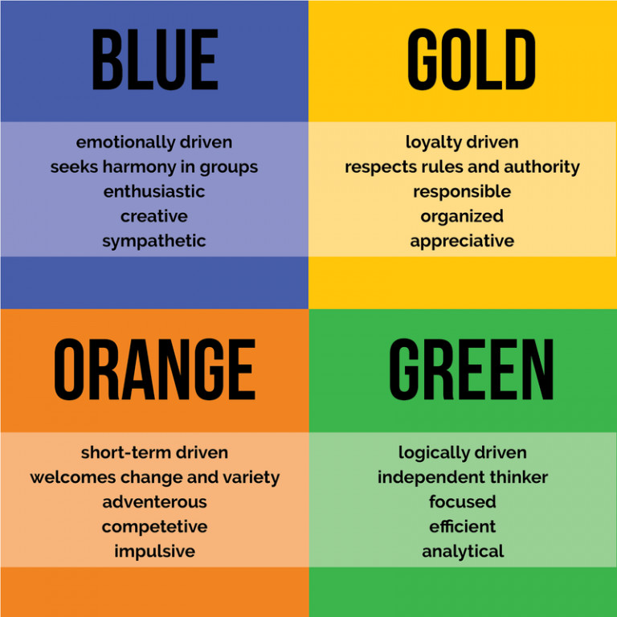
Other Tests
Color Test
Myers-Briggs
https://my-personality-test.com/true-colours

Slide 11
Reading Review: Why self-awareness is essential to workplace success
Is being self-aware important?
Self-aware
a greater understanding of your reactions and motivation,
better management of oneself and others,
the ability to adapt your behavior,
improved relationships and personal growth.
In our research, we measured self-awareness in terms of four facets: Reflection, Insight, Rumination, and Mindfulness

Slide 12
Reading Review: Why self-awareness is essential to workplace success
Reflection
I often reflect on my thoughts.
I do not often think about the way I am feeling*.
I enjoy exploring my “inner self.”
I often reflect on my feelings.
Others would benefit from reflecting more on their thoughts.
Insight
I am interested in analysing the behaviour of others.
I value opportunities to evaluate my behaviour.
It is important to understand why people behave in the way they do.
When I’m feeling uncomfortable, I can easily name these feelings.
I usually know why I am feeling the way I do.
Mindfulness
I am often on auto-pilot and do not pay much attention to what I am doing*.
Sometimes I am careless because I am preoccupied, with many things on my mind*.
I often dwell on the past or the future, rather than the present*.
My mind often wanders when I am trying to concentrate*.
Rumination
I often find myself thinking about past negative events.
When things go wrong, I often ruminate on them for long periods of time.
I tend not to look back and think about how I could have done things differently*

Slide 13
To Improve Your Team, First Work on Yourself
internal self-awareness
understanding your feelings, beliefs, and values
Questions asked:
What emotions am I experiencing?
What am I assuming about another person or the situation?
What are the facts vs. my interpretations?
What are my core values, and how might they be impacting my reactions?
external self-awareness
Feedback
Question asked
What am I doing in team meetings that is helpful?
What am I doing that is not helpful?
If you could change one part of how I interact with the team, what would it be?
personal accountability
holding themselves accountable
take personal responsibility for solving the problem

Slide 14
An Overview of the Myers-Briggs Type Indicator
Extraversion (E) – Introversion (I)
Extraversion (E) is the outward turning
Introversion (I) is the inward turning
Sensing (S) – Intuition (N)
Sensing (S) is learning from own senses
Intuition (N) is learning from patterns
Thinking (T) – Feeling (F)
Thinking (T) is using logic
Feeling (F) is using emotions
Judging (J) – Perceiving (P)
Judging (J) is performing structure and firm decisions
Perceiving (P) is being open, flexible, and adaptable
Each type is then listed by its four-letter code:
ISTJ - The Inspector
ISTP - The Crafter
ISFJ - The Protector
ISFP - The Artist
INFJ - The Advocate
INFP - The Mediator
INTJ - The Architect
INTP - The Thinker
ESTP - The Persuader
ESTJ - The Director
ESFP - The Performer
ESFJ - The Caregiver
ENFP - The Champion
ENFJ - The Giver
ENTP - The Debater
ENTJ - The Commander

Slide 15
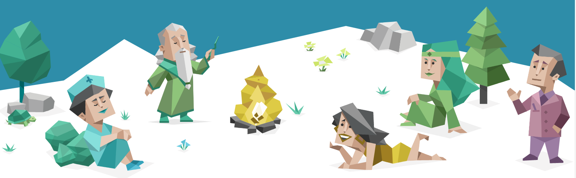
Take the quiz
https://www.16personalities.com/

Slide 16
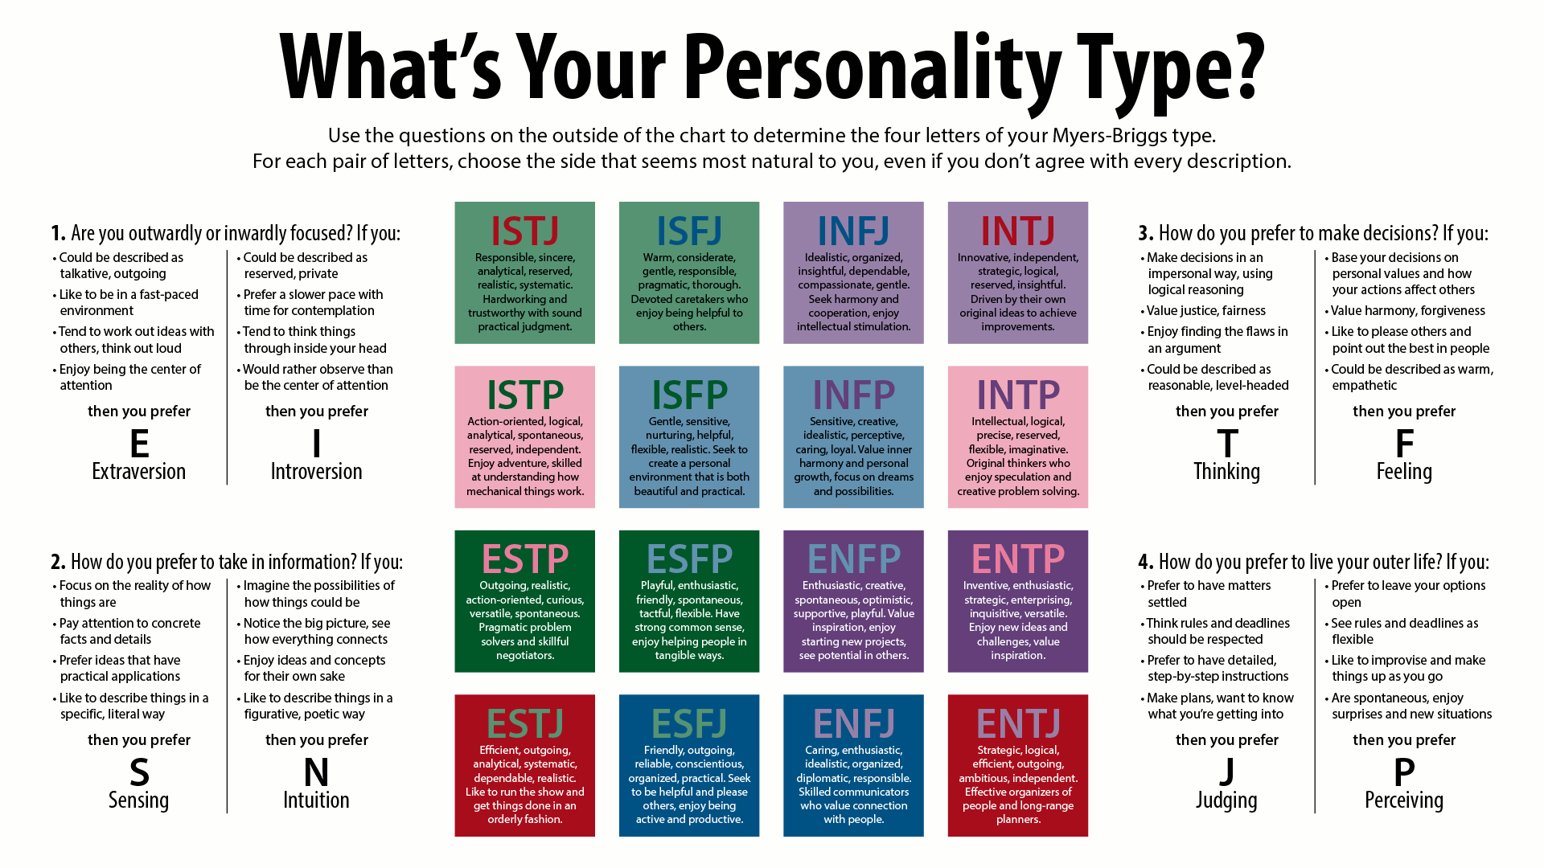

Slide 17
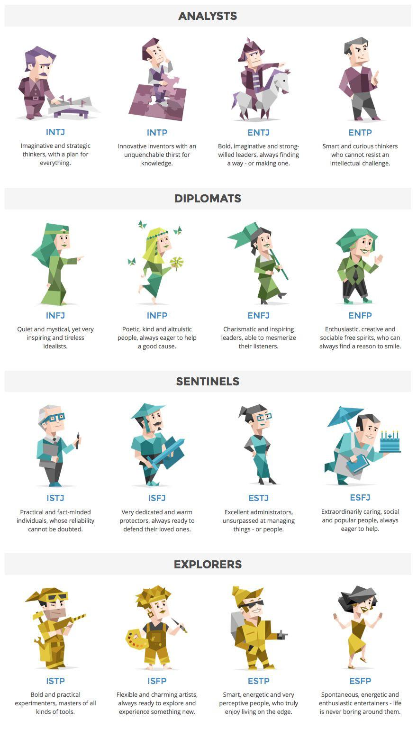
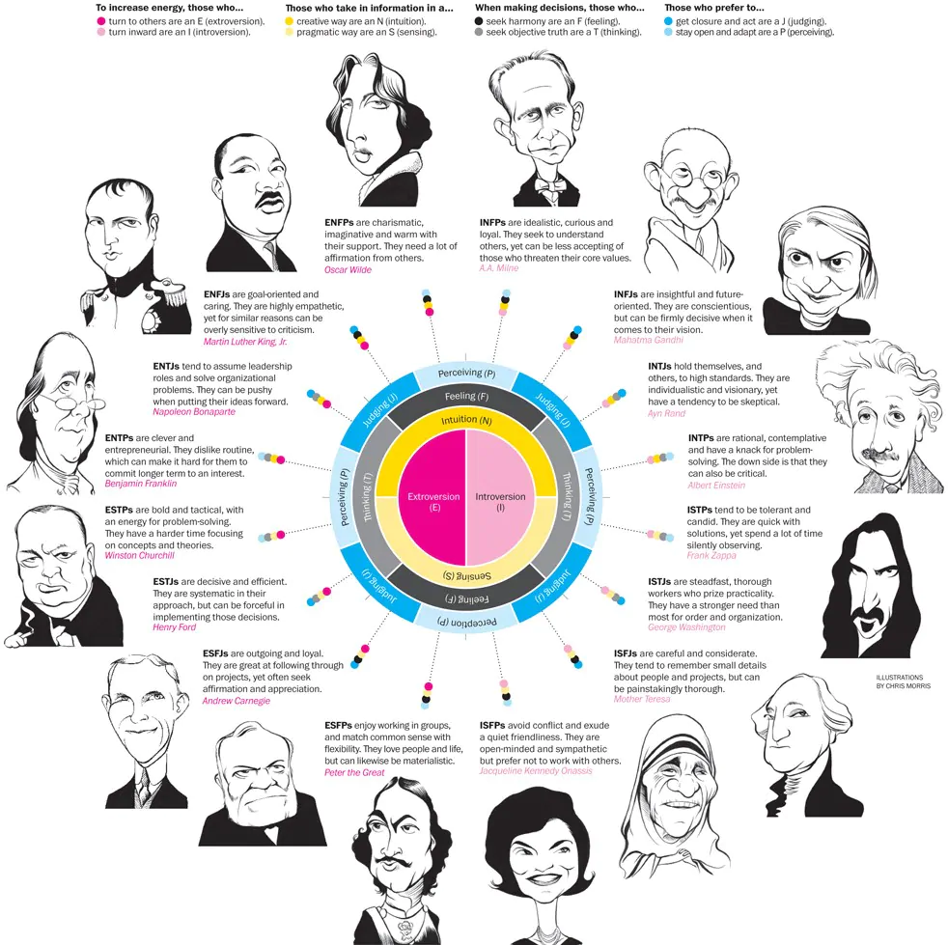

Slide 18

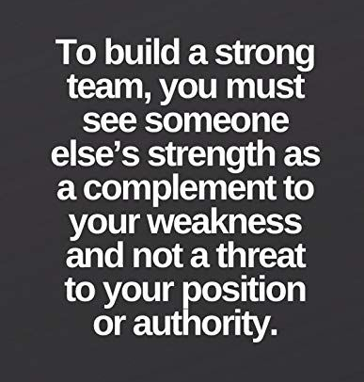
Teammates
How do you see your teammates?
Differences
Personality Traits
Diversity
Experience
Age
Sex
Culture
Adversary or Counterparts?

Slide 19

Video

Slide 20

Scenario – Mr. Porter
Start new job at Slick Tix, been there 6 months
Girl friend: Rebecca
Graduated: Software Developer
Place: On a business sales trip, after two months of sales trips
As a team this week:
Compare prepare answers and decide what Kevin should do

Slide 21
Next class period

Slide 22
CSE 170 Technical Teamwork
W. Clements
Week 03 Day 2

Slide 23
Agenda
Scenario – Mr. Kevin Porter
Team work game – Fox and Geese

Slide 24
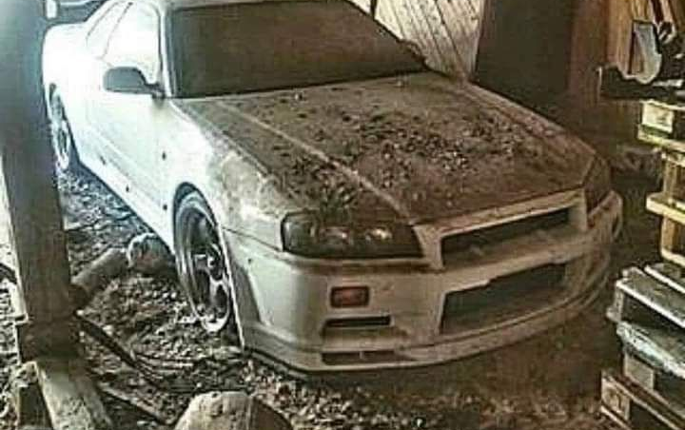
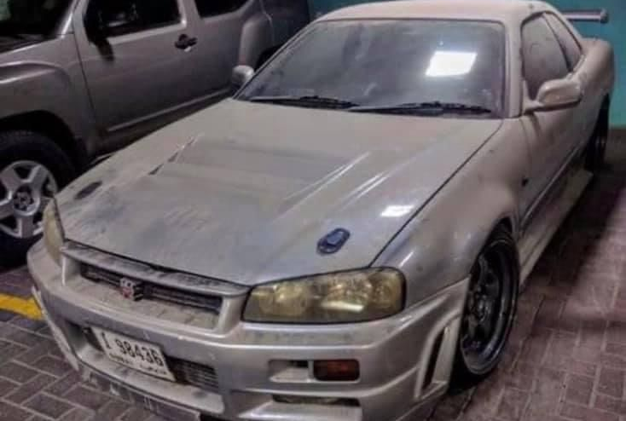
Self Worth
A father said to his daughter “You have graduated with honors, here is a car I bought many years ago. It is pretty old now. But before I give it to you, take it to the used car lot downtown and tell them I want to sell it and see how much they offer you for it.” The daughter went to the used car lot, returned to her father and said, “They offered me $1,000 because the said it looks pretty worn out.” The father said, now “Take it to the pawn shop.” The daughter went to the pawn shop, returned to her father and said,” The pawn shop offered only $100 because it is an old car.” The father asked his daughter to go to a car club now and show them the car. The daughter then took the car to the club, returned and told her father,” Some people in the club offered $100,000 for it because it’s a Nissan Skyline R34, it's an iconic car and sought by many collectors” Now the father said this to his daughter, “The right place values you the right way,” If you are not valued, do not be angry, it means you are in the wrong place. Those who know your value are those who appreciate you......Never stay in a place where no one sees your value.

Slide 25
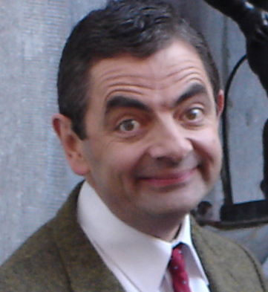
Scenario – Mr. Kevin Porter
Belief & Perceptions
How does Kevin view his problem? What choices does he have?
Are there other ways of looking at the problem? Other choices?
How do Kevin's beliefs influence his perceptions?
Self-Awareness and Decision Making
Do you think Kevin is an introvert, extravert or ambivert? Why?
Should this be part of his decision? Why or why not?
How can knowing this help him make a more reasoned decision?
What Should Kevin Do?
What are the consequences of each choice?
Is Kevin stuck if he makes the wrong one? Why or why not?
What do you think Kevin should do? Why?
Introduction – situation
What is Slick Tix?
Kevin’s 1st few months – expectations, situations
Many Hats - promotion, company problem, SME The Decision: Stay or go?

Slide 26
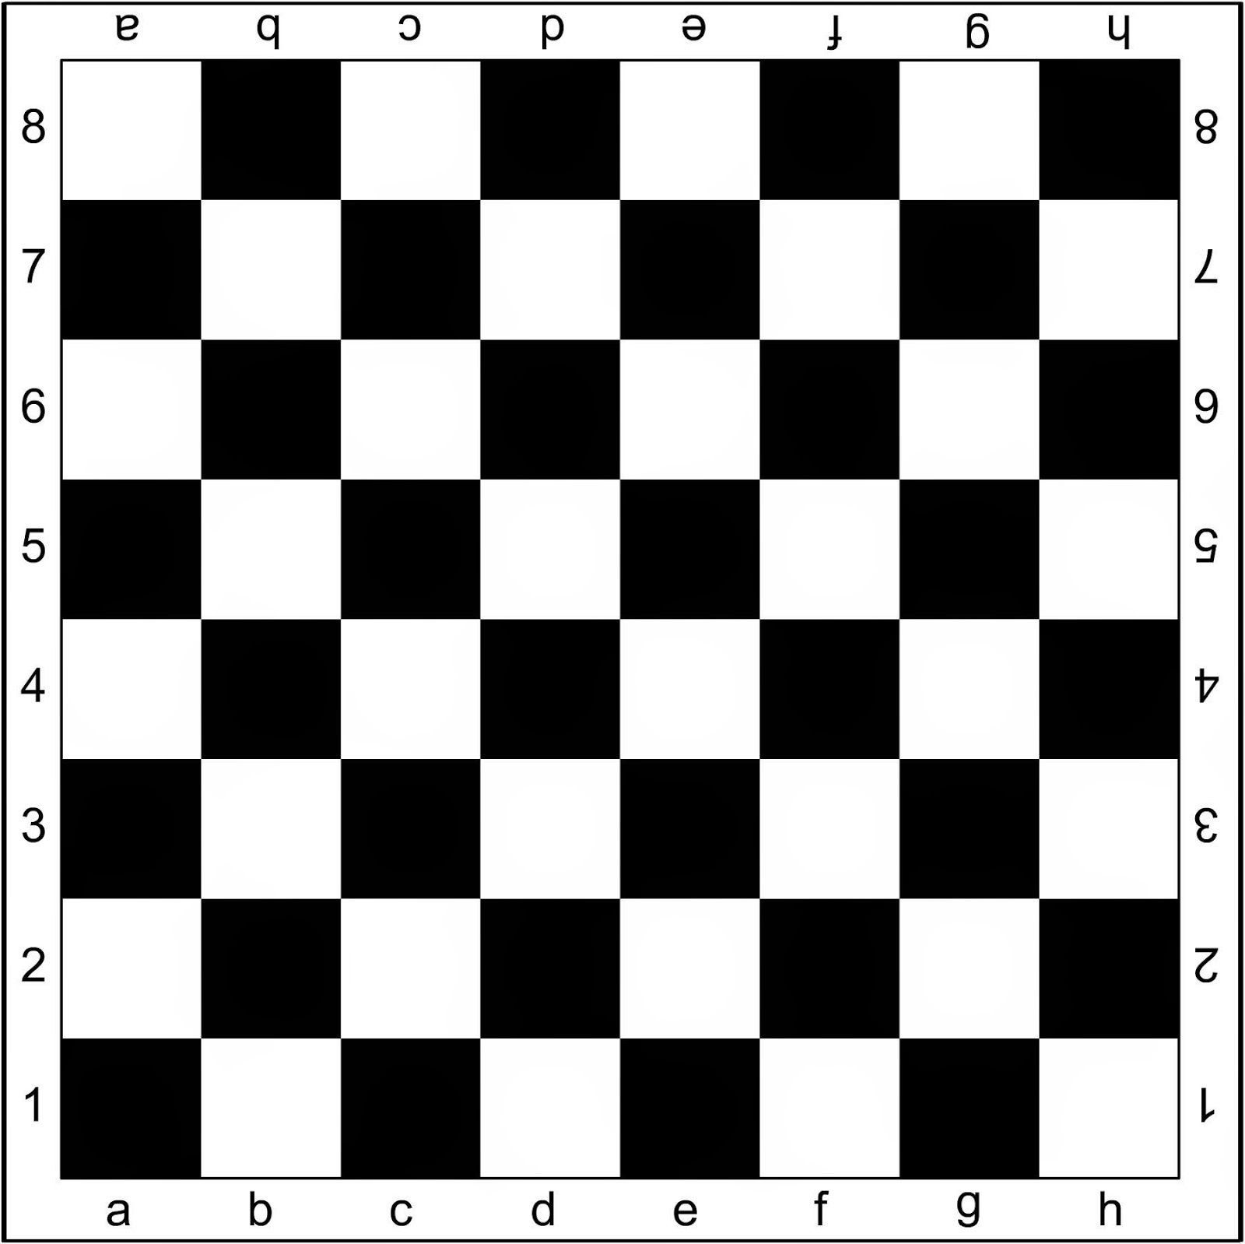
Activity - Fox and Geese
F
Purpose: Learn that with handicap and as a team you can work together to overcome obstacles.
Objective
The player controlling the four geese wins if they manage to block the fox from moving. The fox wins if he manages to traverse to the back row of the opposite side. The geese may also win if they manage to traverse to the opposite side.
Play
Turns alternate with the fox moving first.
One of four geese may only move diagonally forwards one step at a time, per turn.
The fox also only moves one step diagonally at a time, but it may move forwards or backwards.
Thus, all counters are confined to the black squares.
There is no jumping or capturing.
G
G
G
G

Slide 27
Activity - Fox and Geese
What are the advantages and disadvantages of each piece?
What patterns did you see when playing?
What strategies did you start to use?
What can we learn about teamwork from Fox and Geese?
How does this compare to personally self-awareness

Slide 28
Pattern 1
F
G
G
G
G

Slide 29
Pattern 2
F
G
G
G
G

Slide 30
Pattern 3
G
F
G
G
G

Slide 31
Activity - Fox and Geese
Purpose: Learn that with handicap and as a team you can work together to overcome obstacles.
Objective
The player controlling the four geese wins if they manage to block the fox from moving. The fox wins if he manages to traverse to the back row of the opposite side. The geese may also win if they manage to traverse to the opposite side.
Play
Turns alternate with the fox moving first.
One of four geese may only move diagonally forwards one step at a time, per turn.
The fox also only moves one step diagonally at a time, but it may move forwards or backwards.
Thus, all counters are confined to the black squares.
There is no jumping or capturing.

